Slide 1
2021 ATA® Guidelines for Management of Patients with Anaplastic Thyroid Cancer
Radiotherapy and Systemic Chemotherapy in Loco-regionally confined stages IVA and IVB

Slide 2
Approach towards Radiotherapy and Systemic Chemotherapy in Loco-regionally confined stages IVA and IVB
Goal: To limit the threat from residual macro- or microscopic ATC in the neck for terminal airway and/or esophageal compromise
Radiotherapy is provided after surgery or if unresectable
Based on patient centered goals
  Palliative
  Potentially curative
Different approaches
  Locoregional: most commonly radiotherapy +/- chemotherapy
  Systemic: conventional chemotherapy; also targeted therapies to specific somatic mutations, eg BRAFV600E

Slide 3
Radiotherapy after complete/near-complete (R0 or R1) resection
Following R0 or R1 resection, we recommend that good performance status patients with no evidence of metastatic disease who wish an aggressive approach should be offered standard fractionation Intensity-modulated radiation therapy (IMRT) with concurrent systemic therapy (R.14)
Radiation therapy should begin no later than 6 weeks after surgery (GPS 8)
Patient goals of care, medical and psychosocial fitness for therapy, potential toxicities, financial considerations, and robustness of social support must be prominently considered in the decision to proceed with aggressive multimodal therapy (GPS 9)
Cytotoxic chemotherapy can be initiated within one week of surgery, providing sufficient healing, in anticipation of subsequent chemoradiation (GPS 10)

Slide 4
Radiotherapy for Poor Performance Status
In patients of poor performance status, palliative or preventative (no residual disease present) locoregional radiotherapy over high dose radiotherapy is suggested (GPS 11)

Slide 5
Radiotherapy and/or chemotherapy in patients with unresectable or gross residual locoregionally-confined disease
We recommend that patients who have undergone R2 resection or have unresectable but non-metastatic disease with good performance status and who wish an aggressive approach be offered standard fractionation IMRT with systemic therapy. Alternatively, in BRAF V600E mutated ATC, combined BRAF/MEK inhibitors can be considered in this context (R.15)
  BRAF V600E mutation status to guide therapy is a change from previous guidelines
In patients with unresectable disease during initial evaluation in whom radiotherapy and/or systemic (chemotherapy or combined BRAF/MEK inhibitors) therapy renders the tumor potentially resectable, we recommend re-consideration of surgical resection (R.16)

Slide 6
Radiotherapy treatment volume and techniques
Among patients who are to receive radiotherapy for unresectable thyroid cancer or in the postoperative setting, intensity modulated radiotherapy (IMRT) is recommended (R.17)
  IMRT provides optimal balance of benefit versus potential toxicity
  Acute toxicity: skin erythema, moist desquamation, mucositis of the esophagus, trachea, and larynx, and xerostomia
  Late toxicity: skin telangiectasias, skin pigmentation, soft tissue fibrosis, and mild lymphedema, esophageal stenosis

Slide 7
Role of chemotherapy combined with radiotherapy as neo/adjuvant therapy in locoregionally-confined (Stages IVA or IVB) ATC
The use of cytotoxic chemotherapy involving a taxane (paclitaxel or docetaxel), administered with or without anthracyclines (doxorubicin) or platin (cisplatin or carboplatin), is recommended in patients treated with definitive-intention radiation (R.18)
Figure 1-ATC Guidelines 2020

Slide 8
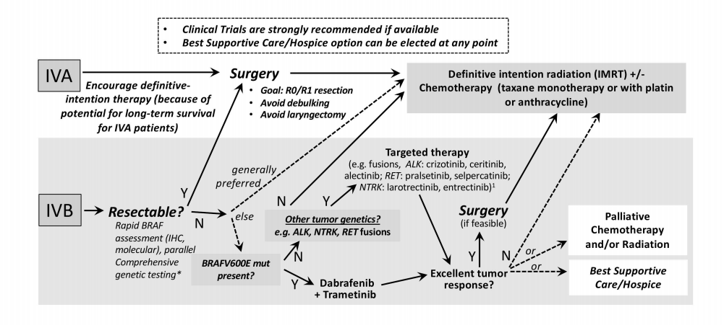
Management of stage IVA and IVB disease
Initial therapy
Follow-up

