Slide 1
2021 ATA® Guidelines for Management of Patients with Anaplastic Thyroid Cancer
Systemic therapy for unresectable ATC stage IVB and stage IVC patients & Approach to Metastases

Slide 2
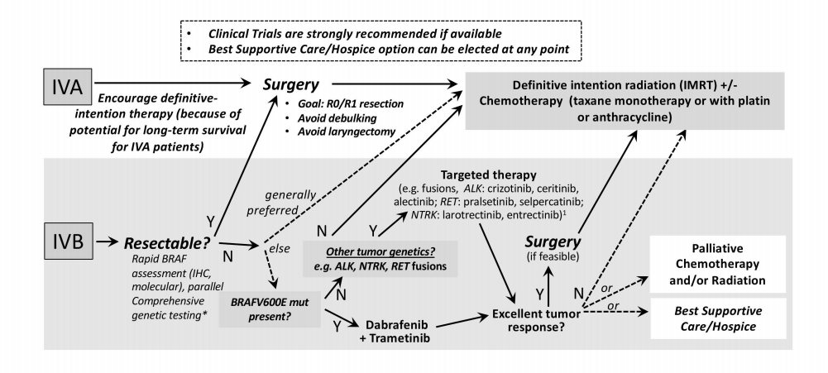
Systemic therapy for unresectable ATC stage IVB and stage IVC patients
ATC patients with unresectable or advanced disease wishing aggressive therapy, we recommend early initiation of cytotoxic chemotherapy as an initial and potentially bridging approach until mutational interrogation results and/or mutationally-specified therapies might be available, and if appropriate (R.19)
Figure 1- 2021 ATC Guidelines

Slide 3
Systemic therapy for unresectable ATC stage IVB and stage IVC patients
While awaiting molecular information or targeted drug approval, radiotherapy and/or the expeditious initial use of these cytotoxic chemotherapy drugs as ‘‘bridging’’ chemotherapy are prudent among patients wishing aggressive treatment
Table 6. 2021 ATC Guidelines

Slide 4
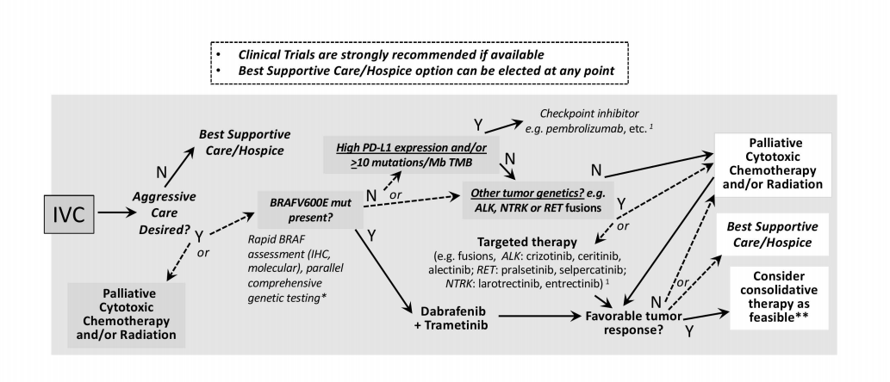
Systemic therapy for unresectable ATC stage IVB and stage IVC patients
*Cytotoxic chemotherapy may be started as a ‘‘bridge’’ while awaiting genomic information or while awaiting targeted therapy (e.g., dabrafenib and trametinib).
**Consolidate Rx refers to focal therapy intended to control residual macrometastatic disease among those electing aggressive therapy.
Dashed arrows depict circumstances where competing therapeutic options may be of consideration
Figure 2- 2021ATC Guidelines

Slide 5
BRAF V600E Mutated ATC
In BRAF V600E mutated IVC and unresectable IVB ATC patients who decline radiation therapy, initiation of BRAF/MEK inhibitors (dabrafenib plus trametinib) is recommended over other systemic therapies if available (R.20)
In BRAF V600E mutated unresectable stage IVB ATC wherein radiation therapy is feasible, chemoradiotherapy or neoadjuvant dabrafenib/trametinib represent alternatives to initial therapy (R.21)

Slide 6
BRAF Non-Mutated ATC
In BRAF non-mutated patients, radiation therapy with concurrent chemotherapy should be considered in an effort to maintain the airway in patients with low burden of metastatic disease (R. 22)
In NTRK or RET fusion ATC patients with stage IVC disease, we recommend initiation of a TRK inhibitor (either larotrectinib or entrectinib) or RET inhibitor (selpercatinib or pralsetinib), preferably in a clinical trial, if available (R23)
In IVC ATC patients with high PD-L1 expression, checkpoint (PD-L1, PD1) inhibitors can be considered as first line therapy in the absence of other targetable alterations or as later line therapy, preferably in the context of a clinical trial. (R. 24)

Slide 7
ATC
Patients with BRAF wild type (BRAF “negative” or unknown mutation status) IVB unresectable or metastatic ATC wishing an aggressive approach and not receiving chemoradiation should be encouraged to participate in clinical trials given the rarity of ATC, the paucity of data in support of improved survival or quality of life from any systemic therapeutics, and the need to develop evidence-based safe and effective therapeutic approaches in advanced ATC. (GPS 7)
Metastatic ATC patients lacking other therapeutic options including clinical trials- recommend cytotoxic chemotherapy (taxane and/or an anthracycline or taxane with or without cis- or carbo-platin) (R.25)

Slide 8
ATC
Therapeutic decision making in the setting of progressive disease after initial therapy regardless of somatic mutational status or therapy is very complex and not easily defined by an algorithmic approach. In this setting, care guided by an expert in ATC therapeutics is best pursued (GPS 8)
As prognosis is dire in metastatic and progressive ATC, best supportive care (hospice) should also be discussed as an option. (GPS9)

Slide 9
Brain Metastases in ATC
MRI Brain*
(Initial Staging-Pre-systemic therapy)
Follow up
Brain MRI if symptoms
Neurologic brain compressive symptoms or signs-
Neurosurgery radiation oncology
Referral
Counseling Increased risk if operating motor vehicles or if placed into situation wherein they may jeopardize themselves or others
Brain Metastases Detected
Dexamethasone
(4-16 mg/day)
Surgery vs Stereotactic radio surgery vs whole brain radiation
*MRI sensitivity higher than CT and FDG PET Scan
Adapted from Approach to Brain Metastases R26-28 & GPS 10

Slide 10
Bone Metastases in ATC
Palliative radiotherapy
Criteria:
Orthopedic fixation
Criteria:
Antiresorptive Therapy
Bisphosphonate infusions
OR
a) Symptomatic or threatening bone metastasis without structural compromise
b)No threatened spinal cord compression
a) Structural compromise in a weight-bearing region
b) Or threatening spinal cord compression
**Fixation needs to occur prior to palliative radiotherapy
Dose reduction if reduced renal function
**With either option calcium and vitamin D supplementation are essential
Subcutaneous RANK Ligand inhibitor
Adapted from Approach to Bone Metastases R29-31

Slide 11
Approach to Other Metastatic Sites
Other metastatic Sites
Pleura/chest wall
↓
Radiotherapy Palliation
Mediastinal nodes-bronchial compression
↓
Palliative
Radiotherapy
Endobronchial lesions
↓
Endobronchial therapy (laser or radiotherapy)
Concept: Thoughtfully individualize therapy in the context of threat posed by lesion

Slide 12
Oligoprogressive Metastatic ATC
Patients on systemic therapy who develop oligo-progressive disease, local tumor-directed therapy may be considered to postpone the need to change otherwise beneficial systemic therapy (GPS 11)
Stereotactic Body Radiotherapy (SBRT)
Radiofrequency ablation (RFA)
Surgery*
Immunotherapy**
Oligoprogressive metastases= 5 or less metastatic lesions
*surgery not typical for metastatic ATC, can be considered on a case-by-case
basis
**addition of pembrolizumab has been described anecdotally

