Slide 1
General Principles for the Safe Performance, Training, and Adoption of Ablation Techniques for Benign Thyroid nodules:
An ATA® Statement
Peri-procedural Considerations

Slide 2
Ethanol Ablation
Aspiration of the cyst under ultrasound visualization with an appropriate gauge needle depending on cyst fluid viscosity
  16-25 gauge needle
  Trans-isthmic approach may prevent extravasation
Without removing needle, slowly inject ethanol 95-99% into the space to about 30-50% of the original cyst volume
  Consider a saline flush/aspiration prior to ethanol injection
  Maintain ultrasound visualization during ethanol injection
  Pain or burning may indicate extravasation

Slide 3
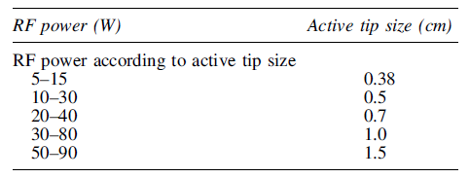
Radiofrequency Ablation (RFA) Equipment
The RFA generator provides 5-80 W continuous power and there are monopolar and bipolar electrodes of variable length with active tips of varying size
  All RFA procedures are performed under US guidance (linear array, 7-14 MHz frequency)
  Monopolar electrodes require a grounding pad and should not be used in the setting of pregnancy or implanted electrical devices
  Selection of wattage and electrode length and active tip size is nodule and operator dependent
  Active tip size influences RF power:

Slide 4
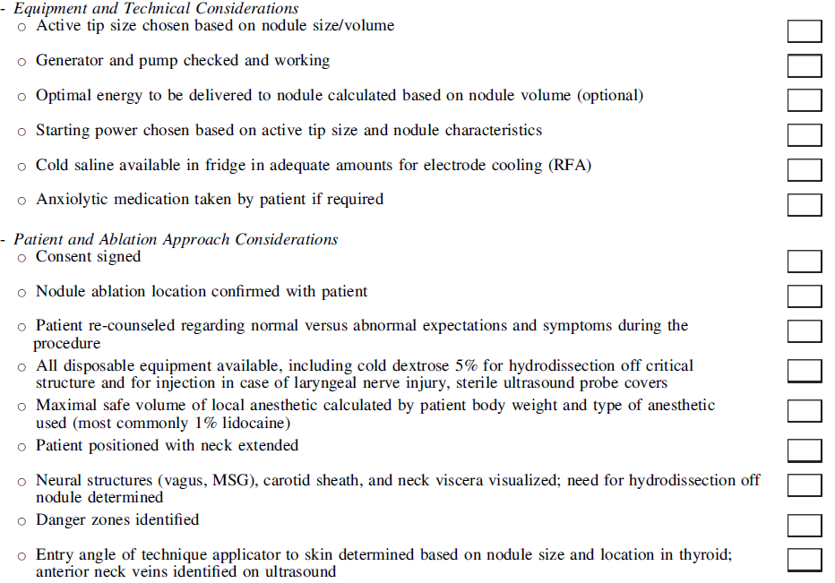
Ablation Peri-procedural Checklist

Slide 5
Anesthesia
There are advantages to different anesthetic approaches:
  Local anesthesia allows the patient to vocalize during the procedure
  Conscious sedation may decrease anxiety and discomfort but prevent early recognition of complications
Local anesthetic is provided in a stepwise fashion:
  Subcutaneous injection in the midline
  Needle is then passed through anesthetized skin and deep to strap muscles to inject lidocaine 1% around the thyroid capsule
Patient weight should be used to calculate maximal lidocaine dose to avoid dangers associated with lidocaine toxicity (utilize dose < 4.5 mg/kg of 1% lidocaine)

Slide 6
RFA Technique
RFA electrode should be passed through the thyroid isthmus into the nodule (trans-isthmic approach)
  Allows visualization of electrode, nodule and location of recurrent laryngeal nerve
  Normal intervening thyroid tissue prevents extravasation of hot fluid
  Electrode position remains stable even with speech/swallowing
Moving-shot technique should be utilized
  Active tip of electrode is placed in deepest portion of nodule and subsequently withdrawn to treat more superficial areas
  This technique prevents limitation of US visualization by gas bubbles generated from treatment effect

Slide 7
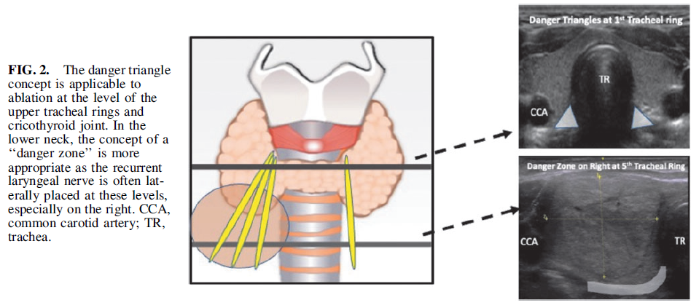
Avoid Ablation in “Danger Triangle” or “Danger Zone”

Slide 8
Managing Acute Complications
Pain during the procedure may indicate damage to critical structures as thyroid parenchyma is mostly insensate
If hoarseness or coughing occurs, the procedure should be stopped immediately
  Injection of a bolus of cold D5W at the site where hoarseness occurred may help dissipate heat
Hemorrhage is typically self-limited with application of pressure but occasionally requires thermal ablation of a small vessel or endovascular/surgical intervention and urgent control of airway for profuse bleeding or expanding hematoma

