Slide 1
General Principles for the Safe Performance, Training, and Adoption of Ablation Techniques for Benign Thyroid nodules:
An ATA® Statement
Considerations for Training and Practical Implementation

Slide 2
Training
Appropriate medical specialty training: Otolaryngology – Head and Neck Surgery, Interventional Radiology, General Surgery with focused practice in Endocrine Surgery, Endocrinology
Preclinical training:
  Participation in thermal ablation education and training course(s)
  Performance of thermal ablation on phantom models prior to direct patient care
Initial ablations on patients should be guided by a proctor with experience in thermal ablation
Practitioners should keep a record of cases, outcomes and complications for self-audit purposes

Slide 3
Learning Curve
Proceduralists should have prior proficiency in thyroid ultrasonography (US) and US guided fine needle aspiration (FNA)
Studies of RFA learning curves involved proceduralists who were already proficient at US and US FNA
  Clinical efficacy ~ 30 cases
  Consolidation phase (continued improvement) 30-60 cases
  Proficiency > 60 cases
Ideal nodule selection during early cases:
  Moderate size (<20-30 ml)
  Non-vascular
  Favorable location (e.g. anterior positioning)

Slide 4
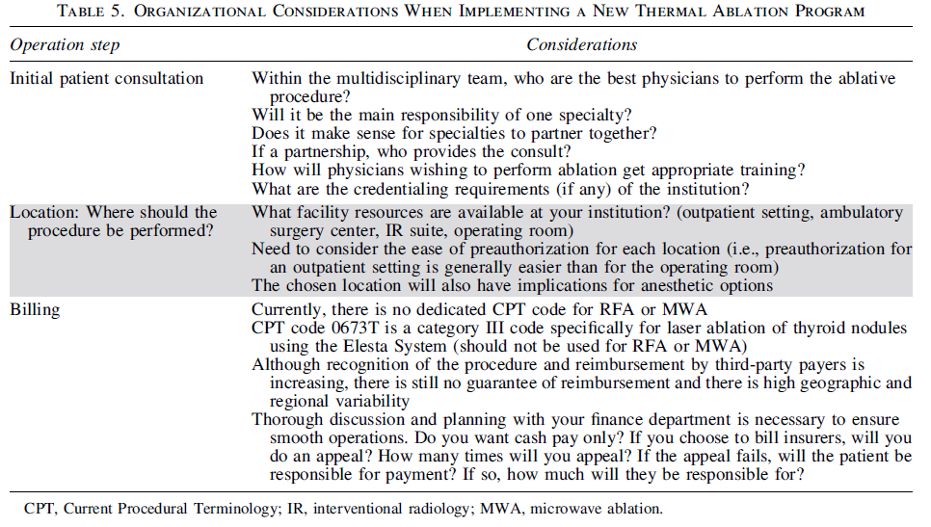
Practical Considerations in Program Development
Consider the questions in the following table:
It may be helpful to develop an operational flow chart (see following slide for example)

Slide 5
